Slide 1
Exploring the relationship between housing prices and school quality
Ross Fu
Data Incubator interview project
May 2, 2016

Slide 2

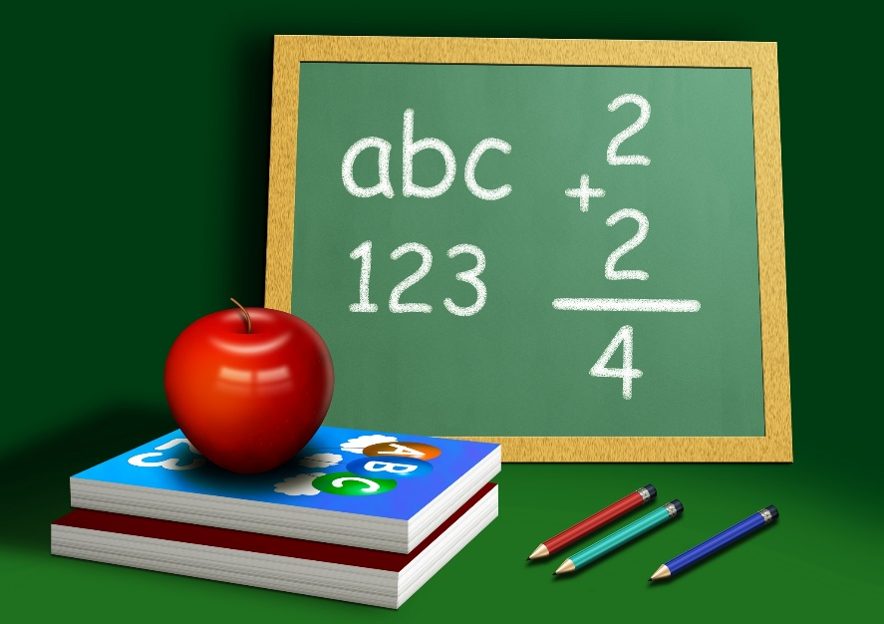
Introduction
What is the correlation between housing prices and school value?
How is school performance correlated with home values?
What is the degree of correlation?
Are home price indices a good indicator of an area's income demographics? Or is price per square foot, or property tax, or something else a more salient metric?
What is the role of charter schools? Do they play a positive or negative role? Do they play different roles in different income areas? What about private schools?
How is the API of a school affected by the race or ethnicity of its students? Is there a correlation between school APIs, home values, and the disparity between white/East Asian students and underrepresented minorities?

Slide 3




Data sources

Slide 4
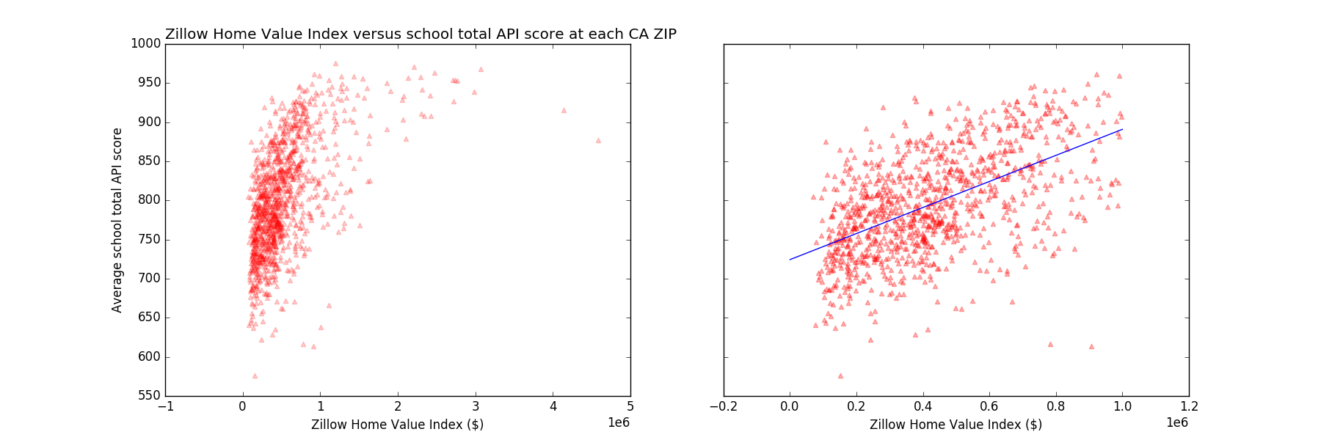
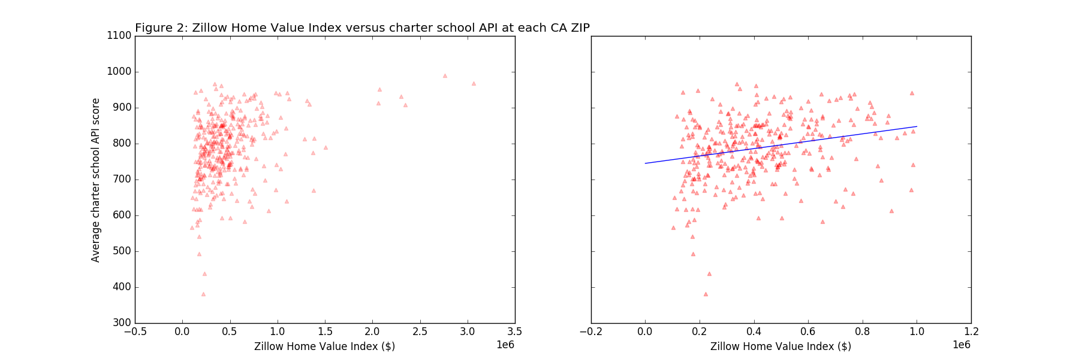
Initial results
 | All Schools | Charter only
Slope x 10⁴ | 1.66546 | 1.0269
Intercept | 724.387 | 744.98
R² | 0.31281 | 0.0636
Pearson's | 0.55254 | 0.3330
Spearman's | 0.59739 | 0.3223

Slide 5
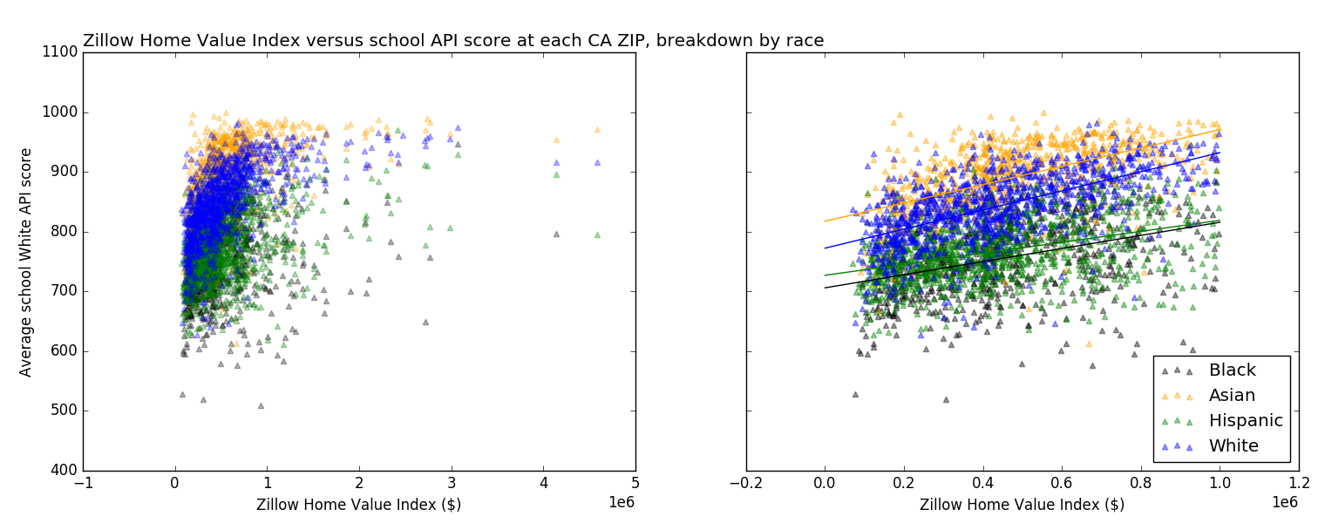
Racial breakdown
 | Asian | Black | Hispanic | White
Slope x 10⁴ | 1.531716 | 1.096435 | 0.918279 | 1.598099
Intercept | 817.405 | 705.9881 | 726.9845 | 772.3306
R² | 0.293611 | 0.125855 | 0.149754 | 0.366764
Pearson's | 0.458479 | 0.205933 | 0.409162 | 0.573052
Spearman's | 0.607966 | 0.340154 | 0.429339 | 0.698472

Slide 6
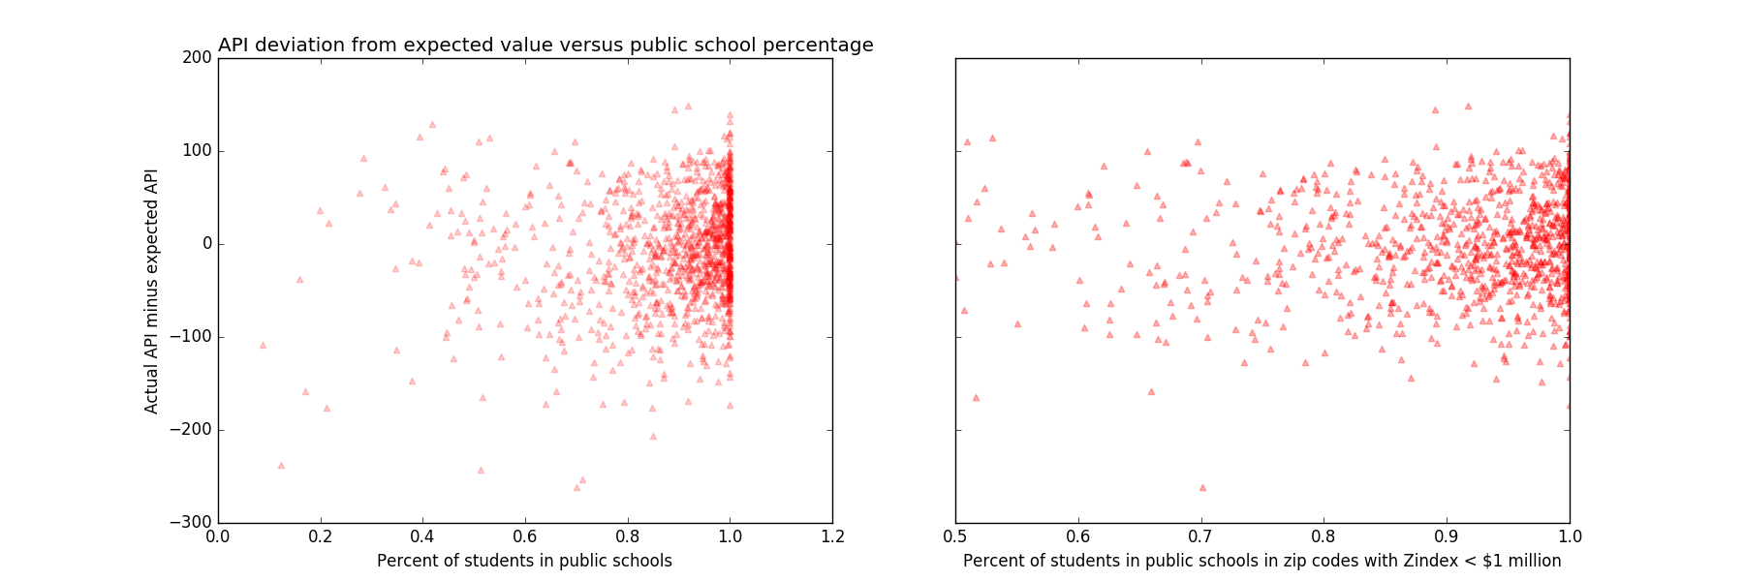
Considerations for private school attendance
Slope | 59.12554
Intercept | -58.8796
R² | 0.022746
Pearson's | 0.150817
Spearman's | 0.151745

Slide 7
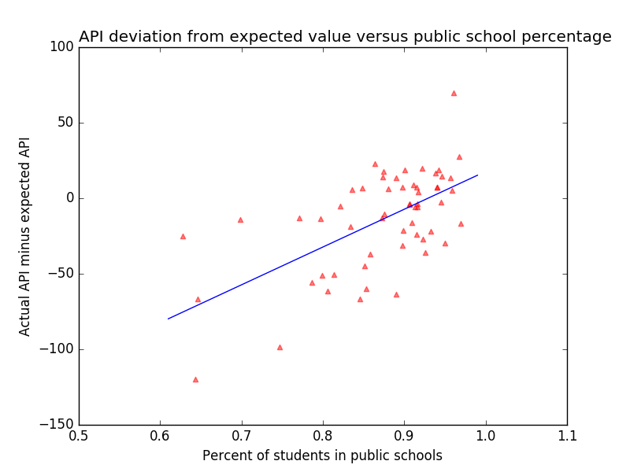
Correlation appears when considering SCFs
Slope | 250.1516
Intercept | -232.425
R² | 0.367393
Pearson's | 0.60613
Spearman's | 0.524371

Slide 8
Conclusions
Home values are loosely correlated with public school performance
Performance of charter schools correlates much less with home values
Breakdown of data by racial groups does not show any particular minority group to have an especially large correlation
Correlation between an area’s private school enrollment and its public school’s deviation from expected performance

